Slide 1

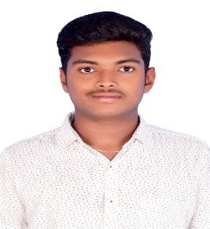
MANOJ SAI PENUGONDA
Advanced App Engineering Analyst
Accenture
Mobile: + 91- 7095258282
Email: manoj.sai.penugonda@accenture.com
Location: Chennai
Relevant Experience
Project Experience: BYTE Prophecy, HUL (JUL 2023 – SEP 2024)
Assigned Role: Advanced App Engineering Analyst
Technology : ReactJS, CSS, HTML and Byte Platform
Performed the role of full – stack frontend developer using React, SQL.
Created data analytic application for client using the byte Platform.
I have worked on developing the application using ReactJS and Configs.
I have worked on CSS properties of the application which include Ag Grid, Bar chart components.
I have created and worked on the Key Performance Indices(KPI) creation and widget configuration using KPI’s and Configs.
Training Experience
Assigned Role: Advanced App Engineering Analyst
Technology : Mongo Db, Express, React and Node JS
I have been trained on MERN stack and I was able to develop a simple shopping cart application, to-do list app, Pizzeria delivery app and login, signup forms.
I have worked on contact manager app, in which I worked on backend part which includes Restful API, user registration, password hashing, Mongoose Schema for Contacts and JWT Authentication.
I have also learned Core Java, Python and SQL and achieved P3+ proficiency in Multiplatform frontend development React and P3 in Java Standard Edition and Python.
I have worked on unit Testing using Chai.
Background
I am an Advanced App Engineering Analyst trained on MERN stack, mainly on Mongo Db, Express, React and Node JS.
I have been part of Splunk dashboard development team for a banking client.
I am also proficient in Core Java and have moderate knowledge of Python and SQL.
I hold a Bachelor’s degree in Electronics Engineering from Madras Institute of Technology, Anna University, Chennai.
Worked on Web Application Development project using ReactJS and Java Script.
Skills:
Java Script
React
Python
SQL
HTML and CSS
Tools :
VS Code
Postman
Eclipse
Copyright © 2024 Accenture. All Rights Reserved. Proprietary and Confidential Information to Accenture.

